Slide 1
Congruence in shapes
Geometrical properties and Pythagoras’ theorem

Slide 2
how to use Oak lessons

Slide 3
I can recognise that for congruent shapes both side lengths and angle sizes are preserved.

Slide 4
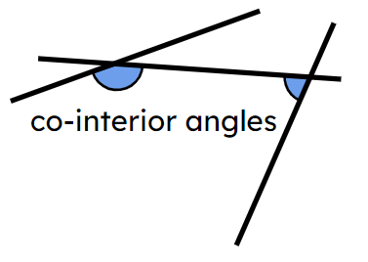
If one shape can fit exactly on top of another using rotation, reflection or translation, then the shapes are congruent.
Co-interior angles are on the same side of the transversal line and in between the two other lines.

Slide 5

Congruence in shapes
Identifying congruence
Solving problems with congruent shapes

Slide 6
Identifying congruence
Shapes which have the same lengths and angles are congruent.
When shapes are not congruent, they are incongruent.
80 mm
88 mm
70°
110°
70°
110°
70 mm
70 mm
77 mm
77 mm
110°
70°
110°
70°
80 mm
88 mm
These shapes have the same angles but they are incongruent because the lengths are different.

Slide 7
Identifying congruence
Shapes which have the same lengths and angles are congruent.
When shapes are not congruent, they are incongruent.
80 mm
80 mm
70°
110°
65°
105°
70 mm
70 mm
70 mm
70 mm
110°
70°
65°
105°
80 mm
80 mm
These shapes have the same lengths but they are incongruent because the angles are different.

Slide 8
Identifying congruence
Shapes which have the same lengths and angles are congruent.
When shapes are not congruent, they are incongruent.
70 mm
80 mm
110°
70°
70°
110°
80 mm
70 mm
70 mm
80 mm
110°
70°
70°
110°
80 mm
70 mm
These shapes are in different orientations but they are congruent because they have the same lengths and angles.

Slide 9

Transformations with congruence
2 cm
The two shapes are congruent.
98°
124°
5 cm
6 cm
82°
56°
6 cm
2.2 m
98°
124°
The shapes have the same angles.
5.5 m
6.6 m
The shapes have different lengths.
82°
56°
6.6 cm

Slide 10
Transformations with congruence
2 cm
The two shapes are congruent.
98°
124°
5 cm
6 cm
82°
56°
6 cm
2 cm
124°
98°
The shapes have the same lengths and angles.
6 cm
5 cm
56°
82°
The shapes are in different orientations.
6 cm

Slide 11
Identifying congruence
Shapes which have the same lengths and angles are congruent.
Not all lengths and angles need to be known in order to determine congruence.
Facts about angles and equal lengths may be used to work out missing measurements on a shape.
Congruence can be determined if enough information is known to ensure that there are no other possibilities.

Slide 12
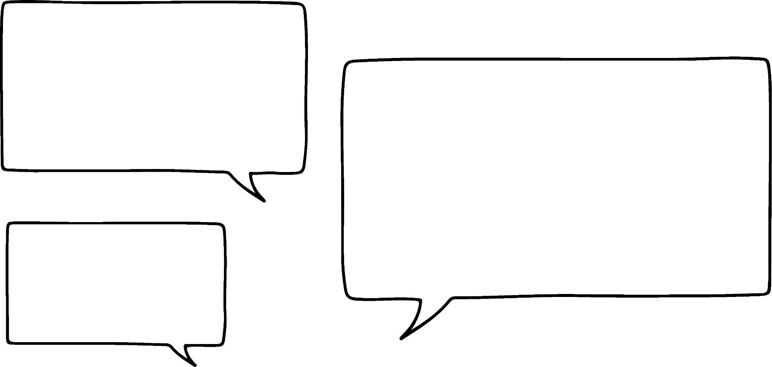


Identifying congruence
Is there enough information to determine whether these shapes are congruent?
I can see that all the angles are the same in the two shapes but I don’t know the lengths.
So, there is not enough information to determine whether they are congruent.
6 cm
B
F
Lucas
A
E
127°
127°
10 cm
8 cm
Izzy
53°
53°
D
C
H
G
12 cm

Slide 13
Identifying congruence
What if I tell you all of the lengths? Can you determine if they are congruent now?
I can see that all the angles and lengths are the same in each shape.
So, yes, I can now be sure that they are congruent.
6 cm
B
6 cm
F
Lucas
A
E
127°
127°
10 cm
10 cm
8 cm
8 cm
Izzy
53°
53°
D
C
H
G
12 cm
12 cm

Slide 14
Identifying congruence
I have removed ∠EFG.
I could work out ∠EFG by subtracting the remaining three angles from 360°.
Is there still enough information to determine congruence?
So, yes, I can still be sure that they are congruent.
6 cm
B
6 cm
F
Lucas
A
E
127°
10 cm
10 cm
8 cm
8 cm
Izzy
53°
53°
D
C
H
G
12 cm
12 cm

Slide 15
Identifying congruence
What if I also remove ∠HEF?
I can see that two of the sides of parallel. I could use the fact that co-interior angles sum to 180° to work out the two missing angles.
Is there still enough information to determine congruence?
So, yes, I can still be sure that they are congruent.
6 cm
B
6 cm
F
Lucas
A
E
127°
10 cm
10 cm
8 cm
8 cm
Izzy
53°
53°
D
C
H
G
12 cm
12 cm

Slide 16
Identifying congruence
What if I also remove ∠GHE?
Is there still enough information to determine congruence?
6 cm
B
6 cm
F
Lucas
A
E
127°
10 cm
10 cm
8 cm
8 cm
Izzy
53°
53°
D
C
H
G
12 cm
12 cm

Slide 17
Identifying congruence
Well, I could work out ∠GHE by using co-interior angles between parallel lines.
6 cm
B
F
Lucas
A
127°
127°
10 cm
10 cm
8 cm
Izzy
53°
D
C
G
12 cm

Slide 18
Identifying congruence
Then, if I draw EF as 6 cm and GH as 12 cm…
…there is only one way to draw the remaining 8 cm length.
6 cm
B
6 cm
F
Lucas
A
E
127°
127°
10 cm
10 cm
8 cm
8 cm
Izzy
53°
53°
D
C
H
G
12 cm
12 cm

Slide 19
Identifying congruence
So, yes. This is still enough information to determine congruence.
6 cm
B
6 cm
F
Lucas
A
E
127°
10 cm
10 cm
8 cm
8 cm
Izzy
53°
53°
D
C
H
G
12 cm
12 cm

Slide 20
Identifying congruence
What if I remove the length of EH?
Like before, I can work out the co-interior angle and draw three edges that I know. Then it doesn’t matter if I know how long EH is because there is only one place it can go.
Is there still enough information to determine congruence?
So, yes, I can still be sure that they are congruent.
6 cm
B
6 cm
F
Lucas
A
E
127°
127°
10 cm
10 cm
8 cm
Izzy
53°
53°
D
C
H
G
12 cm
12 cm

Slide 21
Identifying congruence
What if I remove the parallel markers?
That means I can’t work out ∠EFG.
There are now options for which way EF could go, which would affect the length of EH.
Is there still enough information to determine congruence?
So, no, I cannot be certain they are congruent.
6 cm
B
6 cm
F
Lucas
A
E
6 cm
E
127°
10 cm
10 cm
8 cm
Izzy
53°
53°
D
C
H
G
12 cm
12 cm

Slide 22
Identifying congruence
Find the size of the three remaining interior angles.
B
A
80°
∠DAB = 100°
∠ABC = 80°
∠BCD = 100°
100°
100°
80°
C
D

Slide 23
Identifying congruence
It is possible to work out all the remaining interior angles in this shape.
75°
There is not enough information on the diagram to be able to use any angle facts for the missing angles.
Facts about co-interior angles could be used to work out the remaining angles.

Slide 24
Identifying congruence
Is there enough information to determine whether the shapes are congruent? Justify your reasoning.
8 cm
113°
113°
113°
113°
13 cm
13 cm
67°
67°
67°
67°
18 cm
No. Congruence can not be determined without knowing any of the lengths (e.g. one shape could be an enlargement of the other).

Slide 25
Identifying congruence
Is there enough information to determine whether the shapes are congruent? Justify your reasoning.
8 cm
8 cm
113°
113°
113°
113°
13 cm
13 cm
13 cm
67°
67°
67°
67°
18 cm
18 cm
Yes. The hash markings on the edges mean that the missing length is 13 cm. Therefore, we know that all the lengths and angles in each shape are the same.

Slide 26
Identifying congruence
Is there enough information to determine whether the shapes are congruent? Justify your reasoning.
8 cm
8 cm
113°
113°
13 cm
13 cm
13 cm
67°
67°
67°
18 cm
18 cm
Yes. We know the missing length is 13 cm. Co-interior angles and symmetry can be used to find all the remaining angles.

Slide 27
Identifying congruence
1) The shapes below contain three pairs of congruent shapes. Match the shapes which are congruent. You may use a ruler and protractor to determine congruence.
B
C
D
A
F
E

Slide 28
Identifying congruence
2) Which shapes contain enough information to be able to determine whether it is congruent to shape A? Tick the shapes where congruence can be determined. The diagrams are not drawn accurately and all lengths are given in the same units.
5
112°
68°
112°
68°
4
A
4
B
C
4
D
4
68°
112°
68°
112°
68°
5
5
5
5
5
112°
E
4
F
4
G
4
H
4
68°
68°
112°
68°
112°
68°
112°
5
5
5
5

Slide 29
Identifying congruence
1) The shapes below contain three pairs of congruent shapes. Match the shapes which are congruent. You may use a ruler and protractor to determine congruence.
A and F
B and E
C and D
B
C
D
A
F
E

Slide 30
Identifying congruence
2) Which shapes contain enough information to be able to determine whether it is congruent to shape A? Tick the shapes where congruence can be determined. The diagrams are not drawn accurately and all lengths are given in the same units.
5
112°
68°
112°
68°
4
A
4
B
C
4
D
4
68°
112°
68°
112°
68°
5
5
5
5
5
112°
E
4
F
4
G
4
H
4
68°
68°
112°
68°
112°
68°
112°
5
5
5
5

Slide 31
Congruence in shapes
Identifying congruence
Solving problems with congruent shapes

Slide 32




Solving problems with congruence
Draw a rectangle.
Rest your pencil over the rectangle so that it splits it into two shapes.
Are the two shapes congruent?
I think the two shapes will always be congruent.
I think they can never be congruent.
I think they can sometimes be congruent and sometimes not.
Aisha
Jun
Sofia
Who do you agree with?

Slide 33
Solving problems with congruence
Why is Aisha incorrect?
example of incongruent shapes:
I think the two shapes will always be congruent.
a triangle and a trapezium
Aisha

Slide 34
Solving problems with congruence
Why is Aisha incorrect?
example of incongruent shapes:
I think the two shapes will always be congruent.
two trapezia but with different vertical lengths
Aisha

Slide 35
Solving problems with congruence
Why is Jun incorrect?
example of congruent shapes:
I think they can never be congruent.
two right-angles triangles
Opposite edges in a rectangle are equal length.
Jun
Opposite edges in a rectangle are parallel and alternate angles in parallel lines are equal.

Slide 36
Solving problems with congruence
Why is Jun incorrect?
example of congruent shapes:
I think they can never be congruent.
two trapezia where the vertical lengths are equal
Both contain two right angles and alternate angles in parallel lines are equal.
Jun

Slide 37
Solving problems with congruence
The two shapes are sometimes congruent.
congruent
incongruent
I think they can sometimes be congruent and sometimes not.
Sofia
In what circumstances are the shapes congruent?

Slide 38
Solving problems with congruence
In what circumstances are the shapes congruent?
congruent:
incongruent:
The shapes are congruent when the pencil goes through the centre of the rectangle.

Slide 39
Solving problems with congruence
1) For each question draw a rectangle and then split it according to the instructions.
a) Split the rectangle into two incongruent shapes.
b) Split the rectangle into two congruent shapes.
c) Split the rectangle into three incongruent shapes.
d) Split the rectangle into three congruent shapes.
e) Split the rectangle so that two shapes are congruent and the other is incongruent.
f) Split the rectangle into four incongruent shapes.
g) Split the rectangle into four congruent shapes.
h) Split the rectangle into two pairs of congruent shapes.

Slide 40
Solving problems with congruence
1) For each question draw a rectangle and then split it according to the instructions.
a) Split the rectangle into two incongruent shapes.
b) Split the rectangle into two congruent shapes.
examples:
examples:

Slide 41
Solving problems with congruence
1) For each question draw a rectangle and then split it according to the instructions.
c) Split the rectangle into three incongruent shapes.
d) Split the rectangle into three congruent shapes.
e) Split the rectangle so that two shapes are congruent and the other is incongruent.
examples:
examples:
examples:

Slide 42
Solving problems with congruence
1) For each question draw a rectangle and then split it according to the instructions.
f) Split the rectangle into four incongruent shapes.
g) Split the rectangle into four congruent shapes.
h) Split the rectangle into two pairs of congruent shapes.
examples:
examples:
examples:

Slide 43
Congruence in shapes
If one shape can fit exactly on top of another using rotation, reflection or translation, then the shapes are congruent.
Shapes which have the same lengths and angles are congruent.
Congruence does not mean that the orientation must be the same.
Missing lengths and angles may be worked out to determine congruence.
Not all lengths need to be known in order to determine congruence.

Slide 44

© Oak National Academy 2024.
Produced in partnership with Mathematics in Education and Industry.
Licensed on the Open Government Licence v3.0, except where otherwise stated. See Oak terms and conditions.

